Slide 1
3.8 Digital Processing of Continuous-Time Signals
Sampling of Continuous-Time Signals
Recovery of the Analog Signal
Implications of the Sampling Process
3.9 Sampling of Band-pass Signals

Slide 2
Some concepts:
1. ADC: Analog-to-Digital Converter
2. DAC: Digital-to-Analog Converter
3. S/H : Sample-and-Hold (circuit).
MOOC
4. Anti-aliasing filter.
5. Reconstruction or interpolation filter.

Slide 3
3.8.1 Effect of Sampling in the Frequency-Domain
(a)
Ideal sampling
(b)
t
t
0
0
t
t
0
0
T
T
t
t
0
0
MOOC

Slide 4
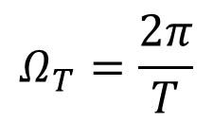
When τ« T, p(t) ~ δ_{T}(t)
(1)In time domain:
(2)In frequency domain:
MOOC

Slide 5
The Relationship Between G(e^{jω}) and G_{p}(jΩ)
Compare:
g[n]=g_{a}(nT), -∞<n<∞
Notes:
G(e^{jω}) 与 G_{p}(jΩ) 存在映射关系：Ω=ω/T

Slide 6
G_{p}(jΩ) 是Ω的周期函数；G_{a}(jΩ) 按 Ω_{T} 的整数倍平移，并且幅度以 1/T 缩放得到各分量，再求和得到G_{p}(jΩ)
From:
We arrive at the desired result:
MOOC

Slide 7
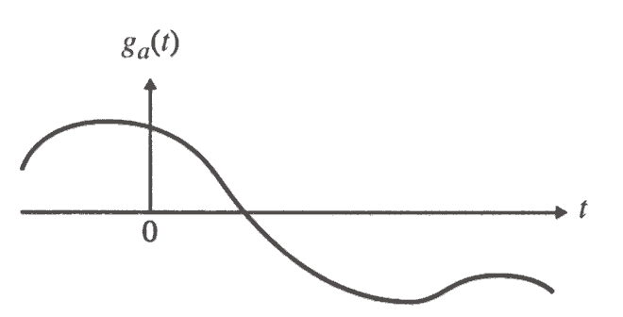
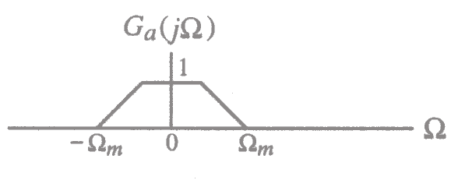
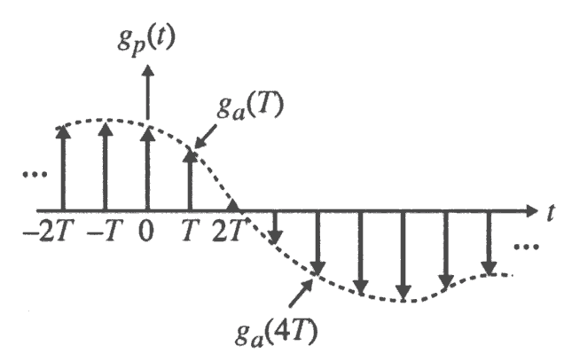
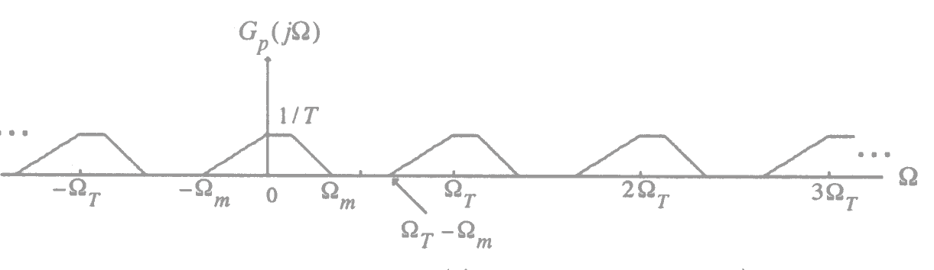
The Discretization The periodization
In time Domain In Frequency Domain
Assume g_{a}(t) is a band-limited signal with a CTFT G_{a}(jΩ)
MOOC

Slide 8
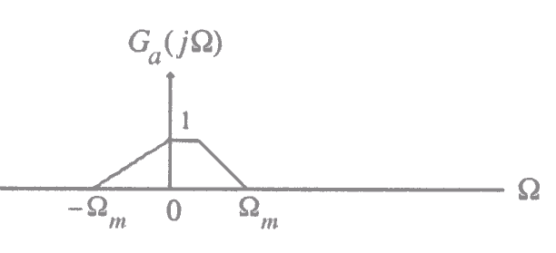
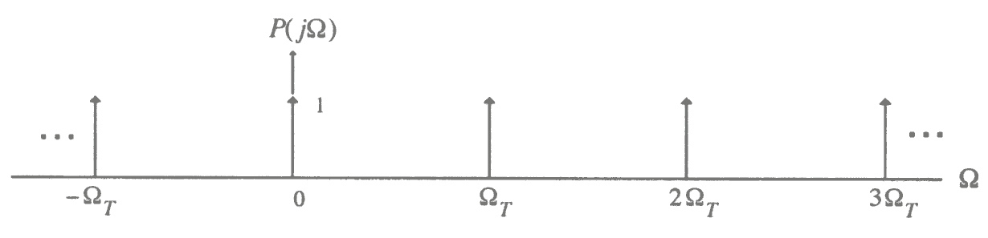
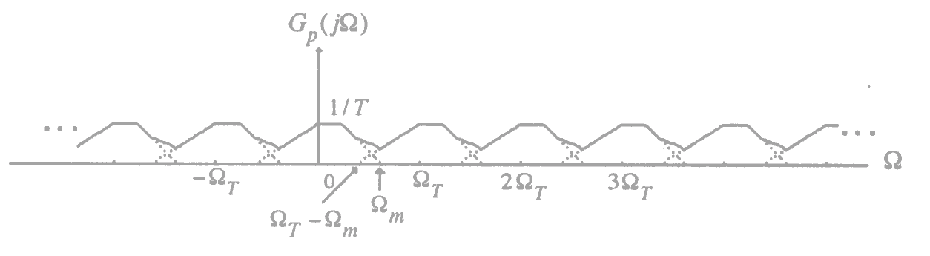
The frequency procedure of sampling
Ω_{T}>2 Ω_{m}
no overlap
Ω_{T}< 2 Ω_{m}
overlap/
aliasing

Slide 9
Sampling Theorem
Let g_{a}(t) be a band-limited signal with CTFT G_{a}(jΩ)=0 for | Ω|> Ω_{m} ,
Then g_{a}(t) is uniquely determined by its samples g_{a}(nT) , -∞≤n≤∞
if Ω_{T} ≥ 2 Ω_{m} , where Ω_{T}=2π/T
The condition Ω_{T} ≥ 2 Ω_{m} is often referred to as the Nyquist condition.
The frequency Ω_{T}/2 is usually referred to as the folding frequency.
The highest frequency Ω_{m} contained in g_{a}(t) is usually called the Nyquist frequency since it determines the minimum sampling frequency Ω_{T} =2Ω_{m}
The frequency 2Ω_{m} is called the Nyquist rate.
MOOC

Slide 10
Oversampling - The sampling frequency is higher than the Nyquist rate;
Undersampling - The sampling frequency is lower than the Nyquist rate;
Critical sampling - The sampling frequency is equal to the Nyquist rate;
Note: A pure sinusoid may not be recoverable from its critically sampled version.

Slide 11
Nyquist frequency Examples:
In digital telephony, a 3.4 kHz signal bandwidth is acceptable for telephone conversation;
Here, a sampling rate of 8 kHz, which is greater than twice the signal bandwidth, is used.
In high-quality music signal processing, a bandwidth of 20 kHz has been determined to preserve the fidelity;
Hence, in compact disc (CD) music systems, a sampling rate of 44.1 kHz, which is slightly higher than twice the signal bandwidth, is used.

Slide 12
Supplement: The practical sampling
实际情况 p(t) 是宽度为τ的周期窄脉冲串
C_{k} 的模随着k变化
0
0

Slide 13
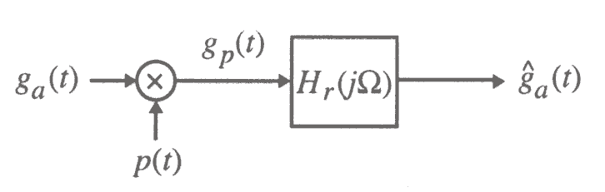
3.8.2 Recovery of the Analog Signal
By filtering in frequency domain or interpolation in time domain, the continuous signal can be recovered from The Sampled Discrete signal.
Here, the filter is called reconstruction filter or interpolation filter or smoothing filter.

Slide 14
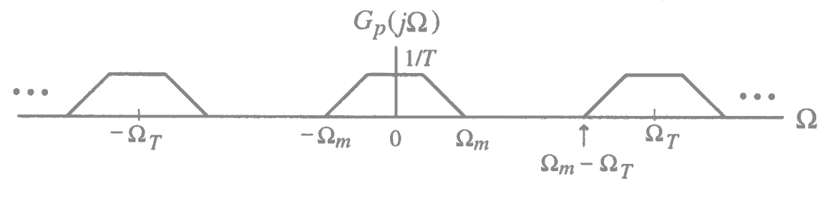
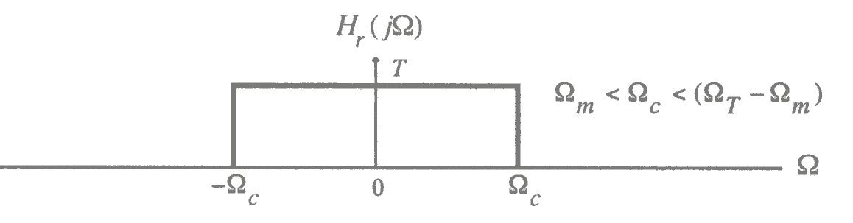
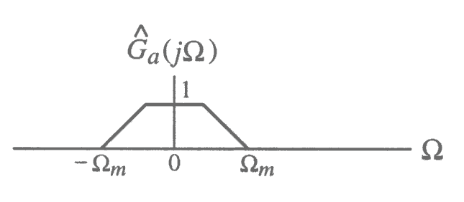
recovery：
若 Ω_{T}>2 Ω_{m}, 让g_{p}(t)通过理想低通H_{r}(jΩ)，即可以恢复出g_{a}(t) ；H_{r}(jΩ)通带幅度按T加权，截止频率满足：Ω_{m}< Ω_{c} < Ω_{T} - Ω_{m}
Notes:
On the other hand, if Ω_{T}< 2 Ω_{m} , due to the overlap of the shifted replicas of G_{a}(jΩ) , the spectrum G_{p}(jΩ) cannot be separated by filtering to recover G_{a}(jΩ). The distortion caused by a part of the replicas outside the baseband folded back or aliased into the baseband.

Slide 15
The impulse response h_{r}(t) of the ideal lowpass filter is obtained by taking the inverse DTFT of H_{r}(jΩ)
The input to the lowpass filter is the impulse train g_{p}(t)

Slide 16
^
Therefore, the output of the ideal lowpass filter is given by:
^
*
^
Poisson sum formula or interpolation formula.

Slide 17
无论是否满足采样定理，都有：
但是只有满足采样定理，才有：
^
MOOC

Slide 18
3.8.3 Implications of the Sampling Process
Example: Consider the three continuous time sinusoidal signals:
Their corresponding CTFTs are:

Slide 19
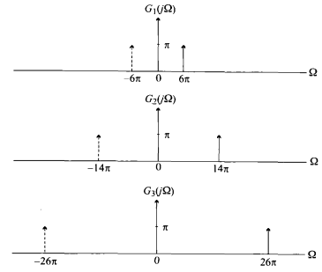
These three transforms are plotted below

Slide 20
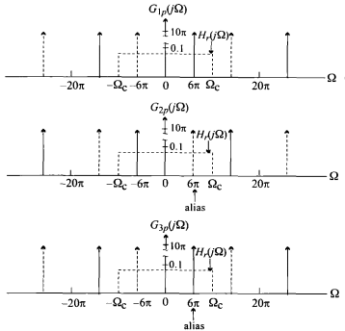
T=0.1s

Slide 21
These figures also indicate by dotted lines the frequency response of an ideal lowpass filter with a cutoff at Ω_{c}=Ω_{T}/2=10π and a gain T=0.1.
In fact, the 3 discrete-time sinusoidal signals are:
And

Slide 22
If reconstruction filter
If reconstruction filter

Slide 23
3.9 Sampling of Band-pass Signals
lowpass signals--DC to Ω_{m}
bandpass signals--0<Ω_{L}≤ |Ω| ≤ Ω_{H} bandwidth: ΔΩ= Ω_{H} - Ω_{L}
If Ω_{H} = M(ΔΩ),
choose the sampling frequency Ω_{T} to satisfy the condition:
Ω_{T} = 2(ΔΩ) = 2Ω_{H}/M
Notes:
采样定理要求采样频率大于等于最高频率2倍：Ω_{T} ≥2 Ω_{H}
带通信号 Ω_{H} 很大, 导致采样频率太高，难以实际应用；引入带通采样！
采样频率为带宽的2倍及以上,即可避免混叠! 此时Ω_{T} 小于2Ω_{H}

Slide 24
Figures below illustrate the idea:
0
(M=3)
no aliasing
0

Slide 25
Figures below illustrate the idea:
0
(M=4)
no aliasing
0

Slide 26
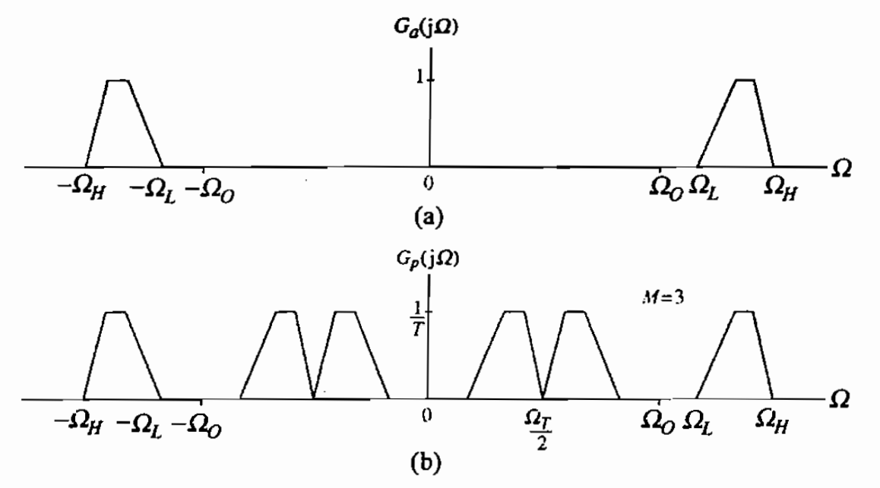
Note:
带通采样只能用于只有一个通带的信号；
若信号不满足条件 Ω_{H} = M(ΔΩ)，则可以放大ΔΩ；
带通采样造成的频率反折：

Slide 27
Homework
3.11,3.17, 3.18(a)(c)(e), 3.23, 3.25, 3.26, 3.43, 3.48, 3.53, 3.58, 3.61, 3.65, 3.66(a)(b)
M3.1, M3.2

